Slide 1
CTL
Meet & Greet
Lorri J. Santamaría, PhD
Director Faculty Development & Inclusive Excellence

Slide 2
Welcome All
Land Acknowledgement, Grounding, + Centering
Introduction
Overview of Plans
Next Few Months
Questions

Slide 3
Land Acknowledgement
Why
  Current efforts toward a shared acknowledgement
Importance of Grounding
  Finding balance on shaky terrain
  Connecting to one’s own people/ cultural moral & ethical compasses
Relevance of Centering
  Attention to shared values

Slide 4
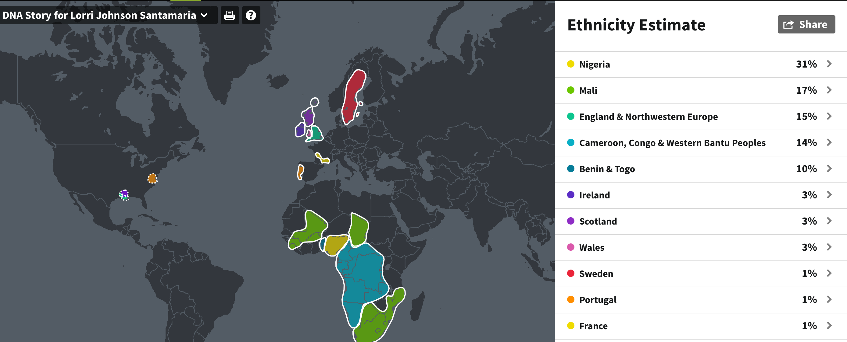

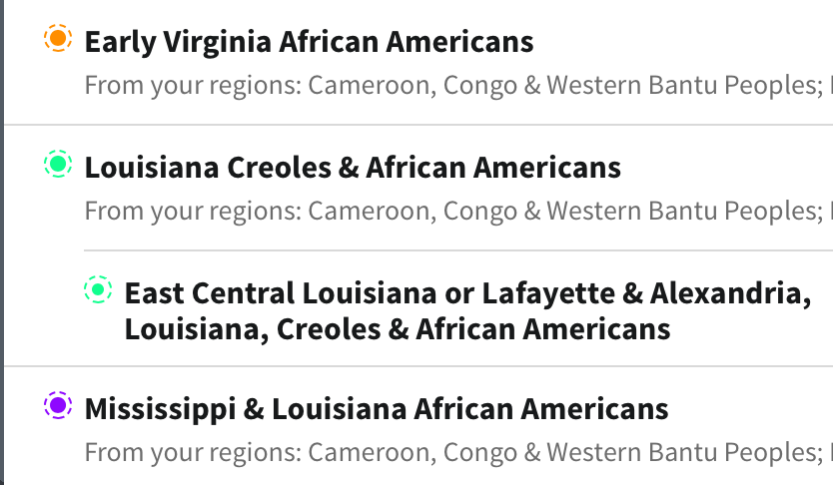
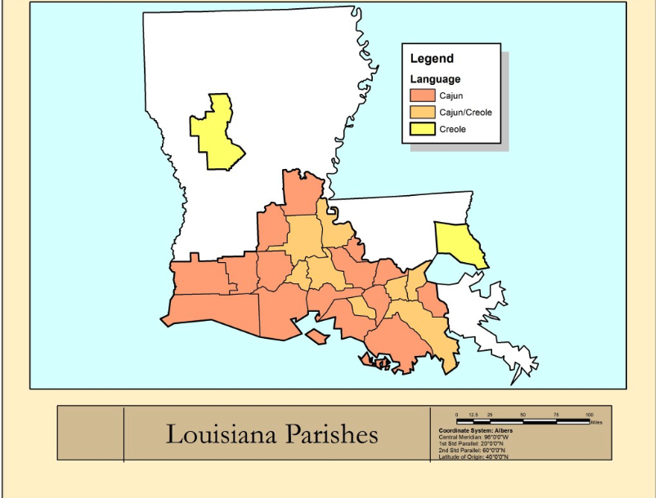
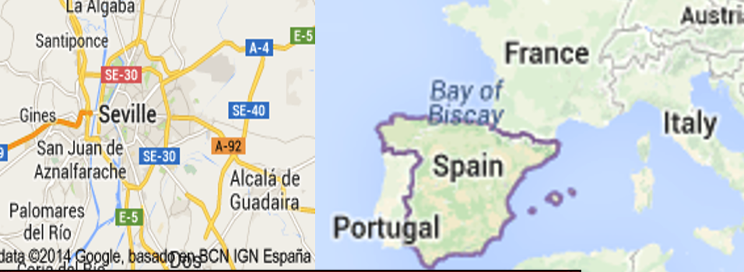


Slide 5
More about me~
I am an equity-oriented experienced twice tenured former professor of transformational educational leadership for diversity with a proven track record promoting:
  Excellence in teaching,
  Exemplary community service,
  Highly cited research (60+ peer-reviewed publications), and
  Evidence-based leadership practices and professional development in HE in multicultural/ multilingual/ Indigenous urban settings in the U.S. and abroad.
  By way of faculty advocacy, mentoring, and support, I promote diversity, equity, inclusion, and collaborative professional practice in higher education.

Slide 6
My intentions
I was brought to you for my track record and the fact that I take Inclusive Excellence seriously.
  I see endless potential, talent, and drive when I look into your faces.
I feel there is no reason why we- a private Lutheran and faith-based institution should not be leading the way regionally and in the state--- regarding diversity, equity, & inclusion.
I am honored, humbled, and 100% committed to leading and facilitating the way,
  and I need your commitment, shared passion, and participation.
  What are some of your motivations for co-signing these efforts?

Slide 7
What you can expect from this office
This Department within the Center for Teaching & Learning is Mission Centered:
  Faculty Deveopment & Incusive Excellence - Delivering culturally responsive and sustaining support with Grace, ease, & dignity.
Driven by rationale:
  Evidence overwhelmingly suggests there is a moral and ethical imperative for ALL educators to see where we can step in and do our parts to meet the rapidly changing needs of mid 21st century students in our region.

Slide 8
Fac Dev + InX future direction
Faculty Development plans, programs, and supports are being designed to align with developing ART DEI standards.
These plans, programs, and supports are being designed to align with current Faculty DEI PD efforts.
  HSI
  CHESS
  Individual School efforts
  DEI Curriculum Committee
  Equity & Incluson Committee
Faculty Development Centered on self-assessment where-in every faculty member:
  Locates oneself along a DEI spectrum or continuum
  Writes/ crafts/ creates a DEI statement or declaration
  Works on a measurable DEI PD plan that makes the most sense to them
  Is held accountable for their movement along the continuum (as decided by academic leadership)

Slide 9
Plan moving forward
Working Collaboratively with VP Cristallea Buchanan and Core DEI Team
Working collaboratively with Digital Learning- Led by Dr. Mirwais Azizi and team
Please begin to send me your specific PD needs as identified in meetings with faculty in your schools and divisions.
I aim to be both responsive to local and more university-wide PD needs over the next year.

Slide 10
Re-working the CLU Syllabus for Inclusive Excellence
4 sessions beginning October 14th
Complement current work of the DEI Curriculum Committee being undertaken by the Office of
Educational Excellence led by Associate Provost Taiwo Ande
October14
Assumptions about Prior Knowledge (hidden curricula; linguistic bias; and suggested guidelines around including resources on the syllabus)
Student and Instructor Expectations
Community Procedures for an Inclusive Classroom Environment

Slide 11
Re-working the CLU Syllabus for Inclusive Excellence
October 28
Assignments and Grading
Reading List and Course Materials
Type of Assignments

Slide 12
Re-working the CLU Syllabus for Inclusive Excellence
November 11
Academic Surveillance
Schedule of Assignments and Late Work
Fire and Sickness Policy
December 9
Technology Policy
Accessibility/Universal Design for Learning
Invitation for Feedback from Students / Co-creation (Module in development)

Slide 13
Thank you – Gracias – T’sha Vindo
Dr. Lorri J. Santamaría
Director Faculty Development & Inclusive Excellence
Center for Teaching & Learning
SBET 111
x3368
lsantamaria@callutheran.edu

